Slide 1




The Alps, Provence, and Barcelona
11 days

Slide 2
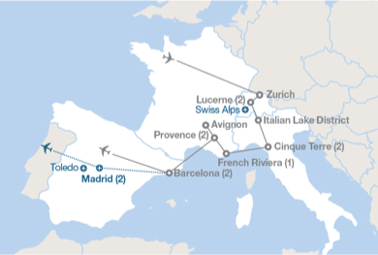
OUR TOUR

Slide 3

LUCERNE, SWITZERLAND

Slide 4
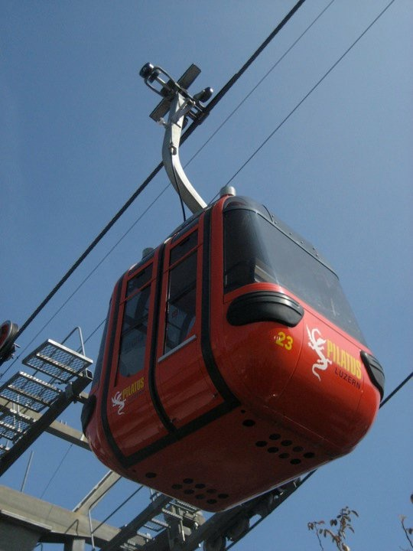



MOUNT PILATUS, SWITZERLAND

Slide 5


A SWISS FEAST FOR ALL YOUR SENSES!

Slide 6

CINQUE TERRE, ITALY

Slide 7






YOUR TUMMY TO ITALY: GRAZIE!

Slide 8

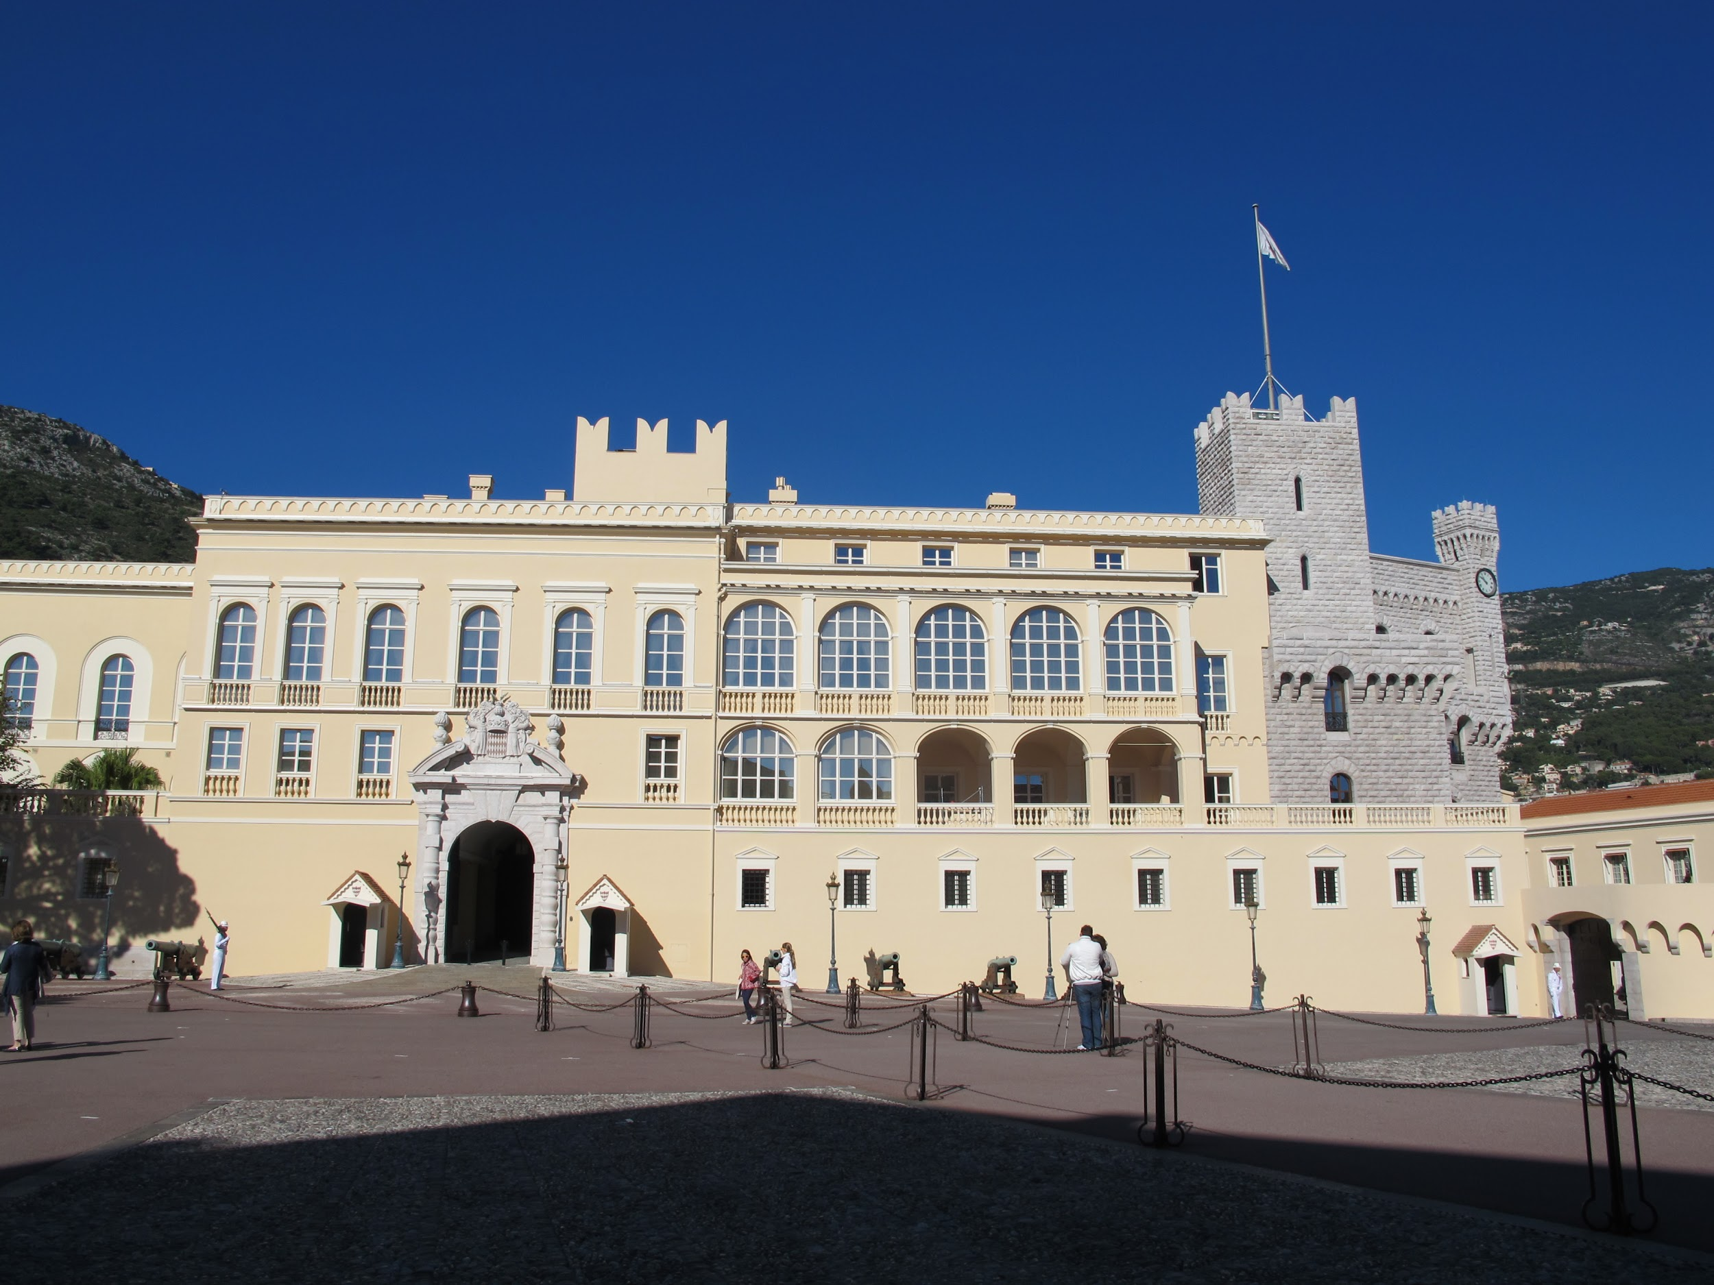
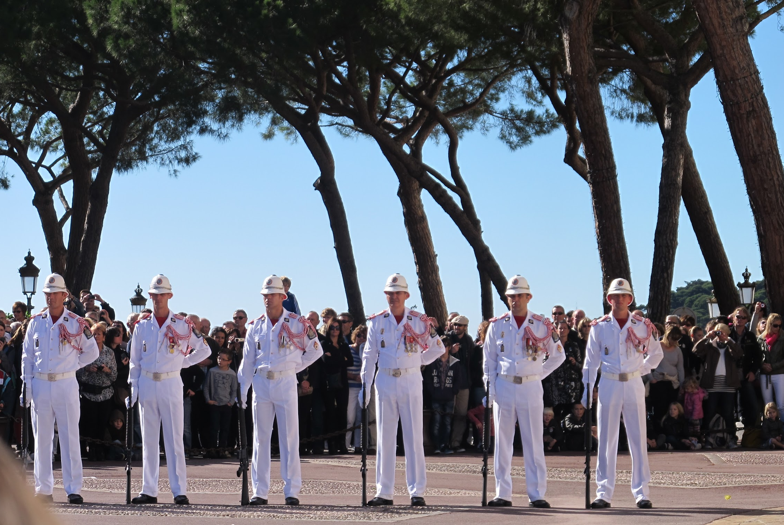
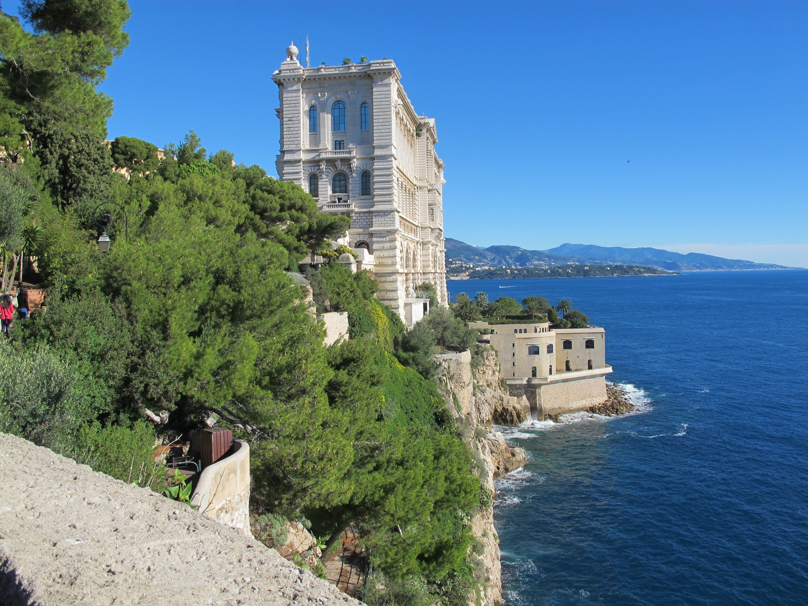
MONTECARLO, MONACO

Slide 9
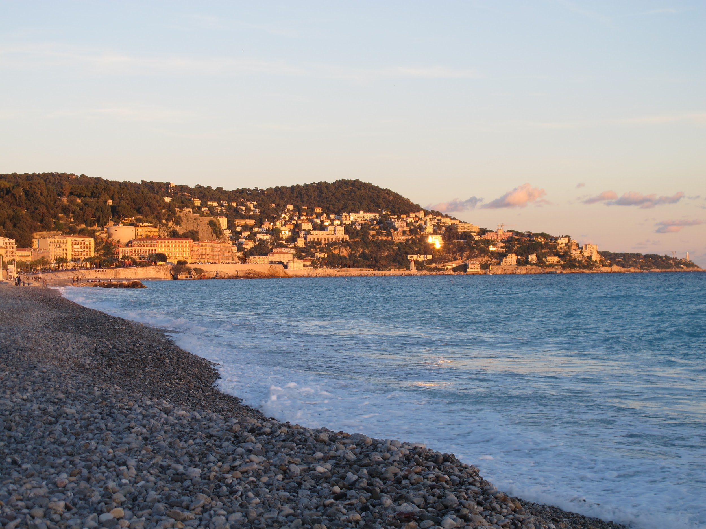
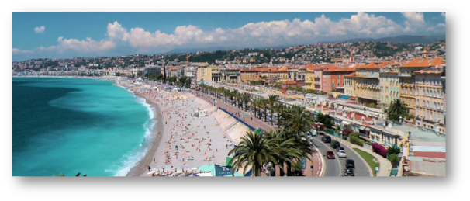
FRENCH RIVIERA, FRANCE

Slide 10
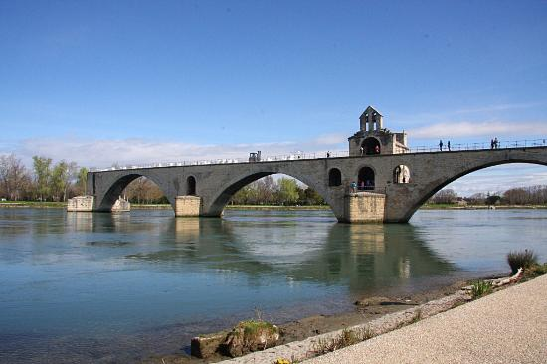

AVIGNON, FRANCE

Slide 11

PONT DU GARD, FRANCE

Slide 12
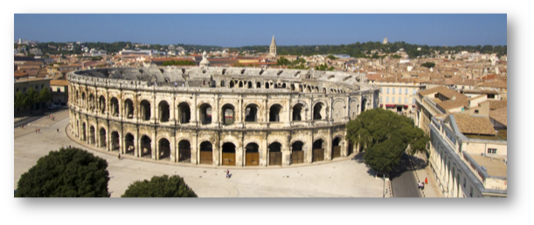
NÎMES, FRANCE

Slide 13





SUPER DÉLICIEUX...YOUR FRENCH PALATE!

Slide 14



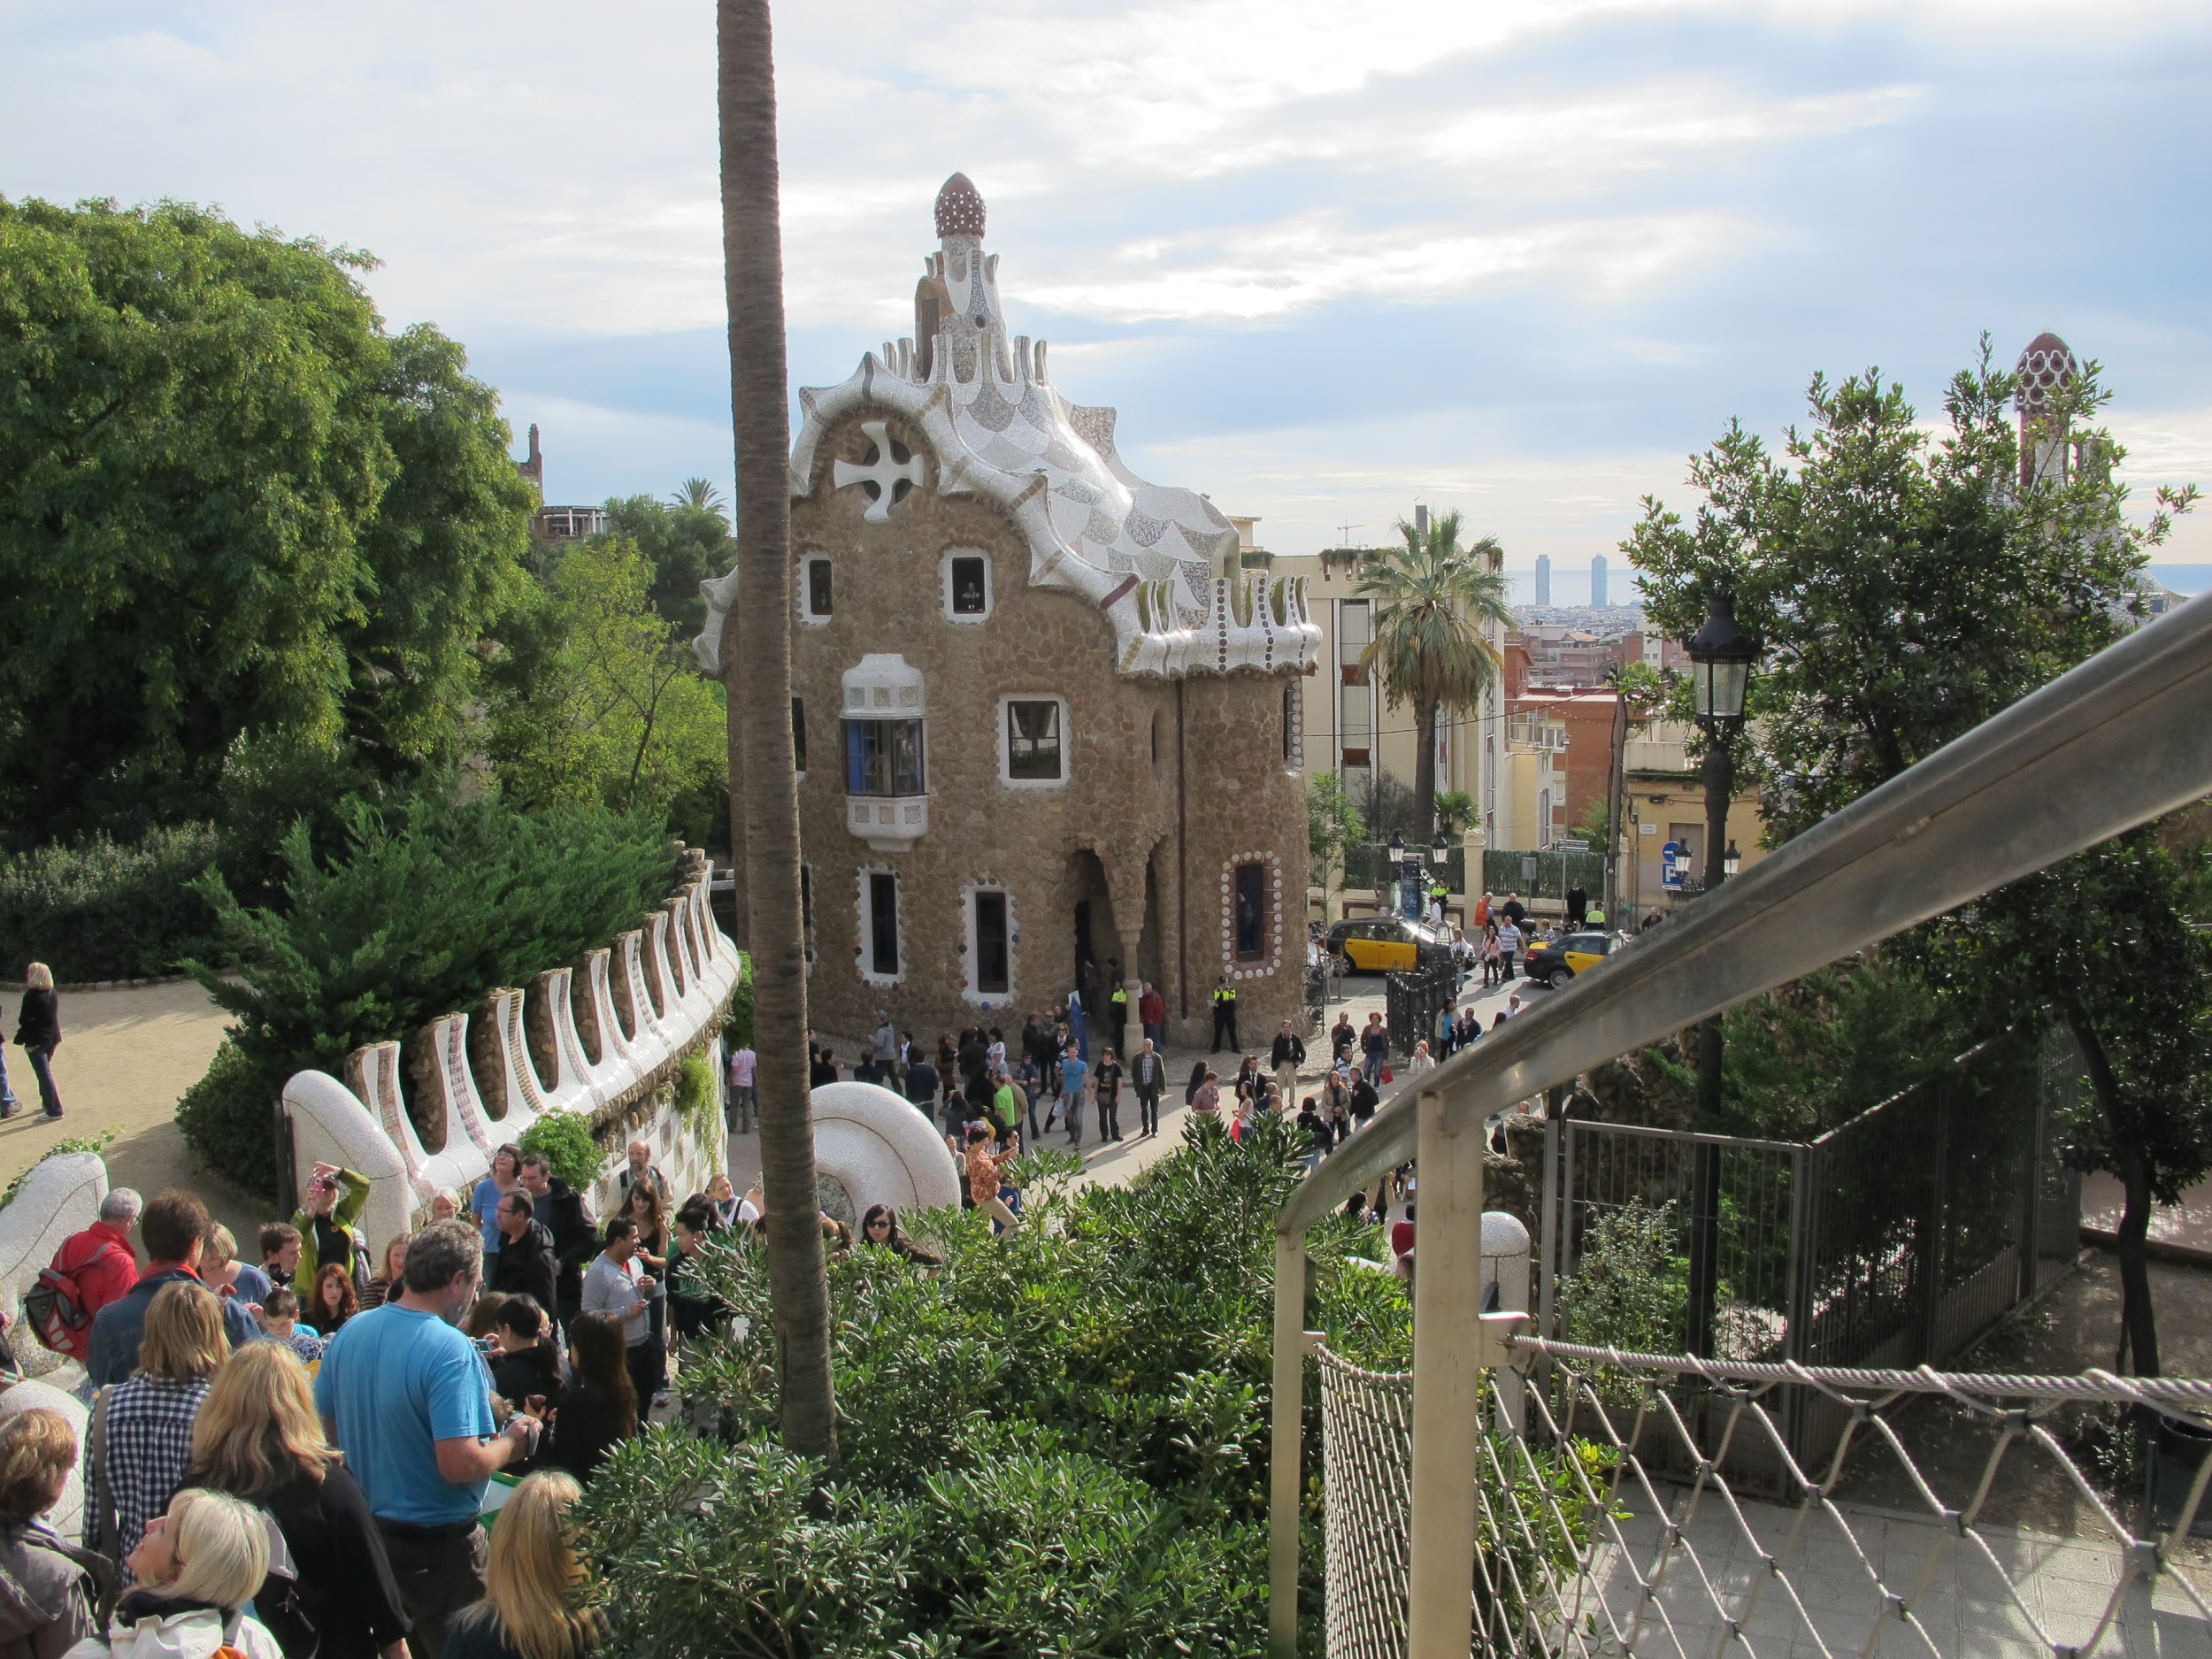


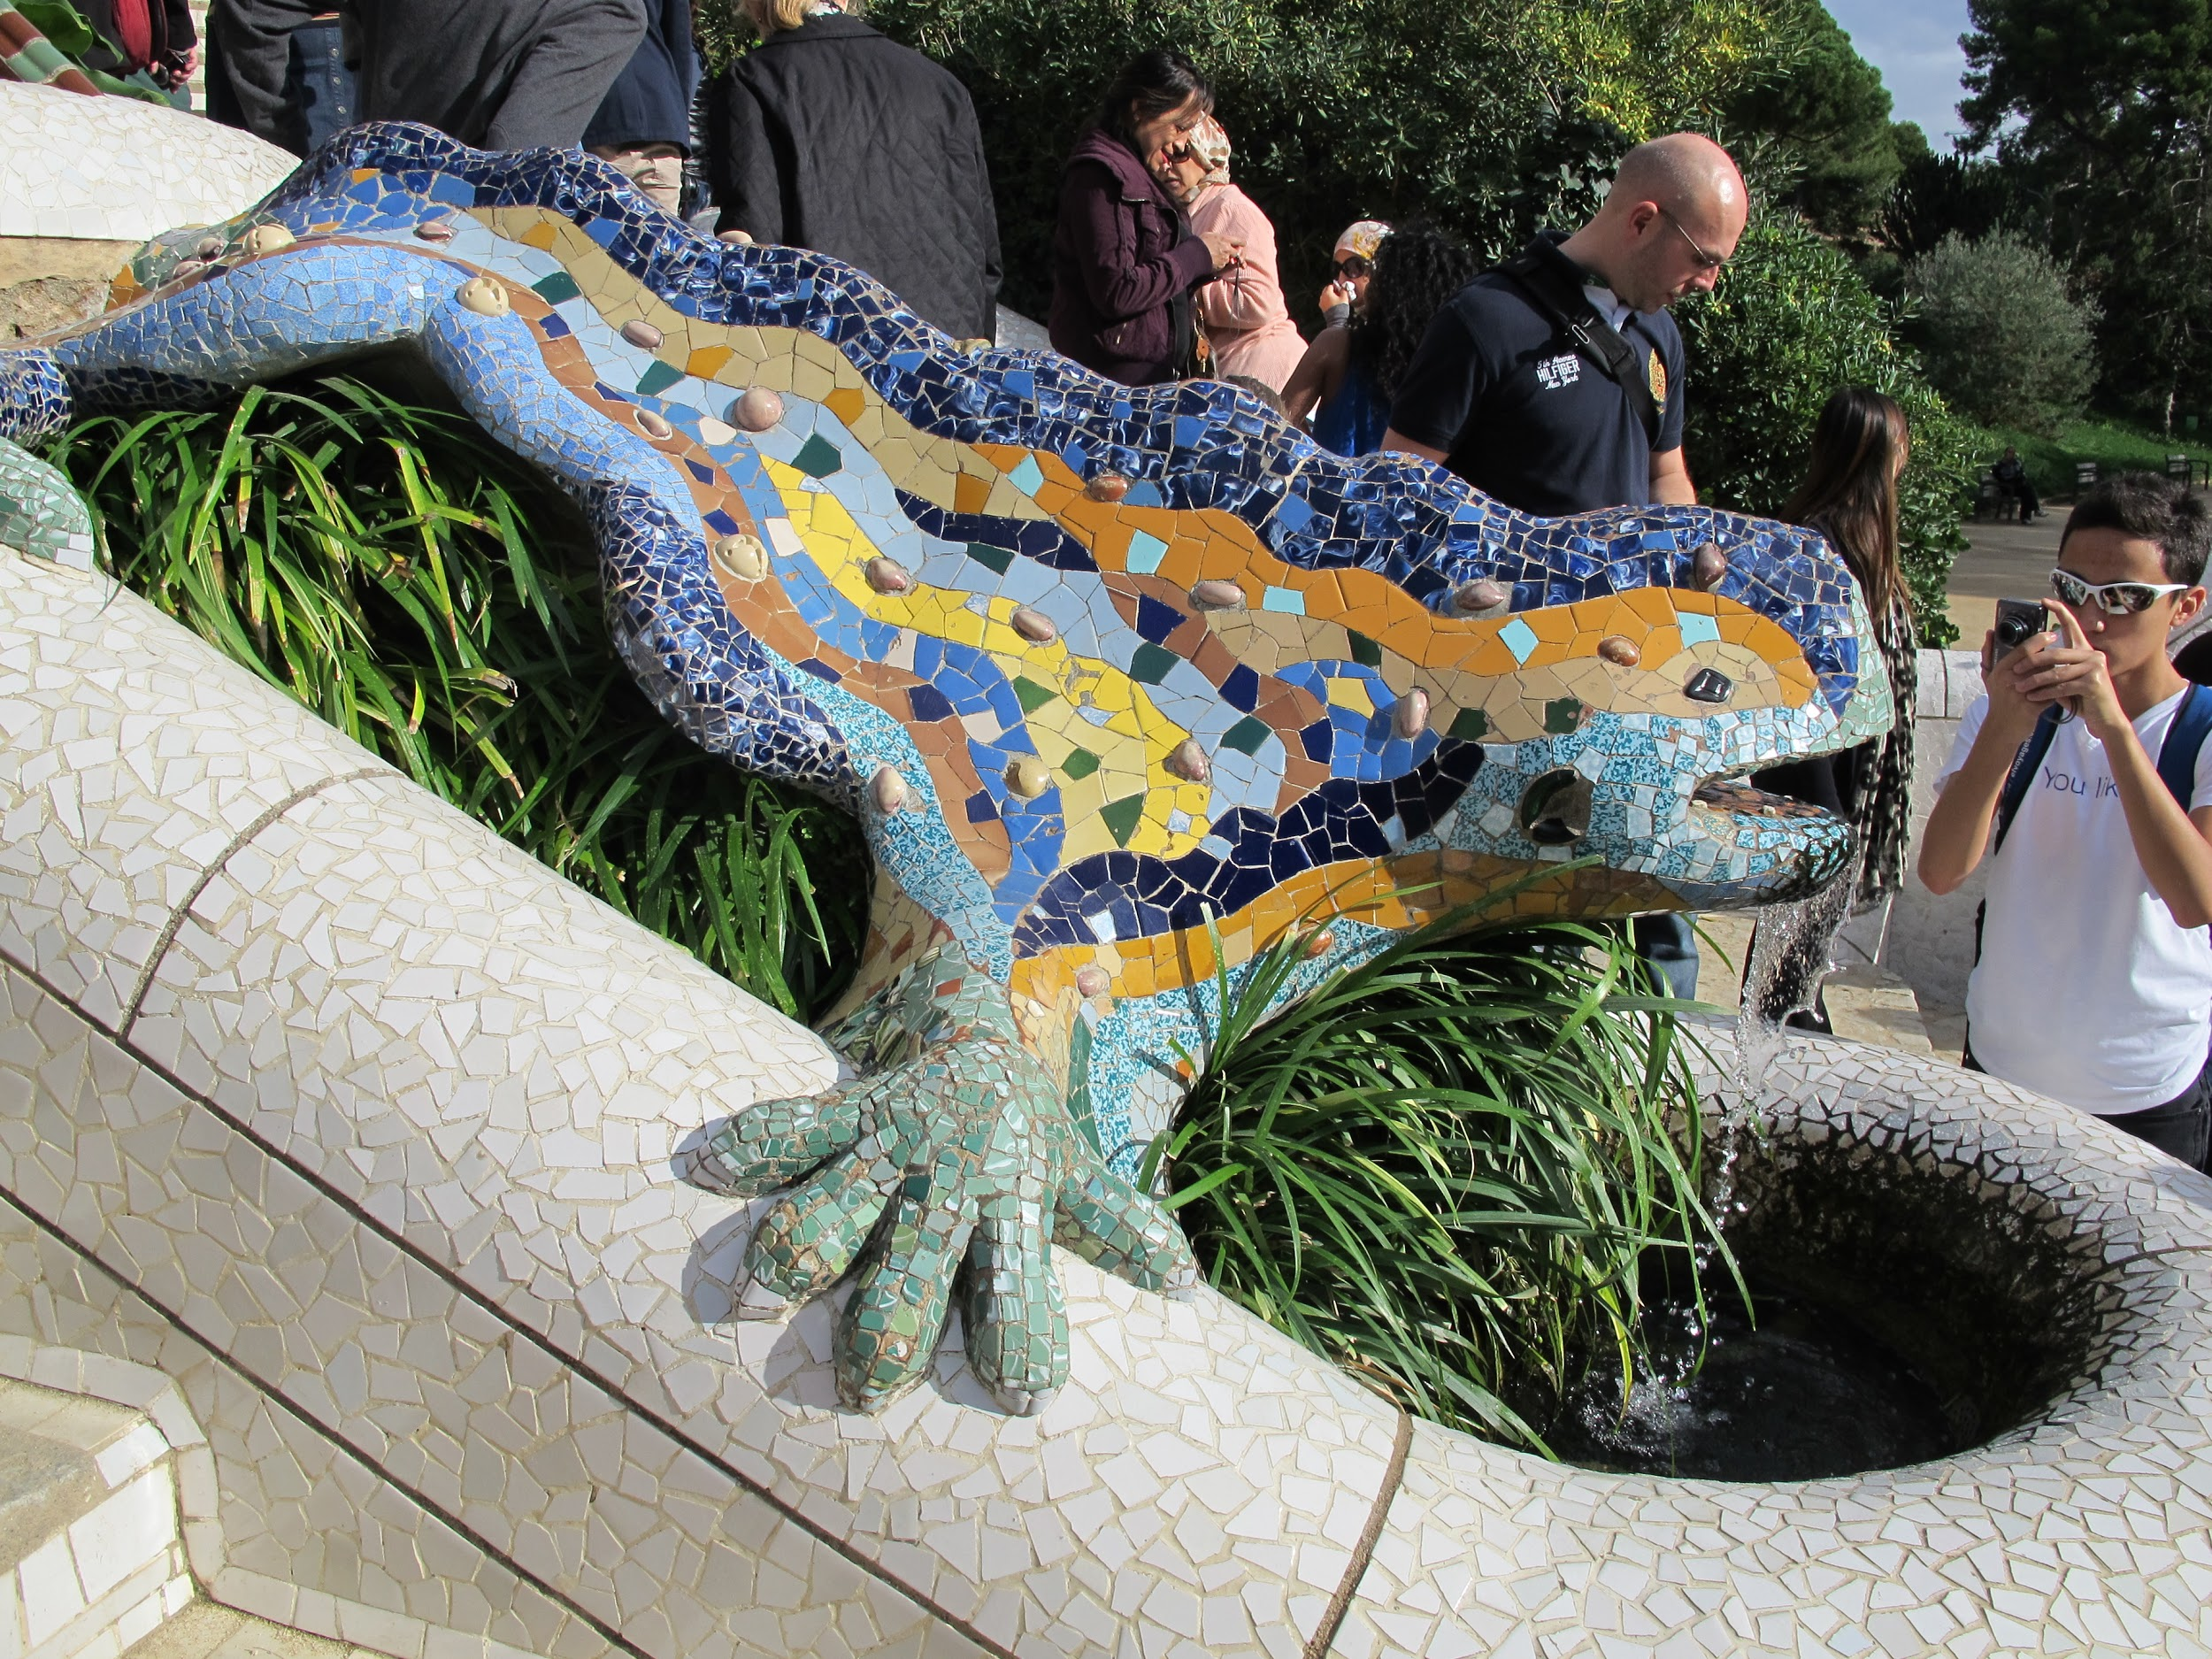
BARCELONA, SPAIN

Slide 15



BARCELONA FOR YOUR TASTE BUDS!

Slide 16
What is included in the costs?
Round-trip airfare
On-tour transportation
Safe, quality hotel rooms
Full-time, bilingual Tour Director
Educational itinerary
Guided tours and activities
Breakfast and dinner daily
24-hour on-tour assistance
Traveller Support Team
Tour Donation page
weShare
Travel gear

Slide 17
PRICE BREAKDOWN
What the original costs were:
PROGRAM PRICE = $3,605
WEEKEND SUPPLEMENT = $40
GLOBAL TRAVEL PROTECTION PLAN = $189
FLAMENCO EVENING BARCELONA = $79
SWISS ALPS EXPERIENCE = $109
SWITZERLAND FOLKLORE = $119
GRATUITY $100
TOTAL = $4, 241
YOUR COST:
$3,599
(LESS $50 IF YOU SIGN UP ON OCT 5TH OR OCT 6TH)
=
$3,549
(YOU SAVE $692)

Slide 18
PAYMENT OPTIONS
Pay in full
Pay the entire balance at the time you enroll
Payment methods accepted: direct debit, from your bank account, personal cheque or credit card (Visa or MasterCard)
Automatic Payment Plan
After you enroll with the $199 non refundable deposit, payments are automatically deducted from your bank account monthly or bi-weekly.
Final payment extended up to one month before your tour
Chequing or savings account accepted
Manual Payment Plan
Receive invoices and make payments in less frequent installments
Accounts must pay the $199 non refundable deposit upon enrollment; $500 due 30 days after enrollment; and additional $500 due 90 days after enrollment
Final payment deadline is 99 days before your tour (for tours departing before September 30, 2019) or 110 days before your tour (for tours departing on or after October 1, 2019)
For travellers enrolling between 175 and 99 days prior to departure: $699 due upon enrolment (includes $199 non-refundable deposit). Remaining balance is due 99 days prior to departure.
Payment methods accepted: direct debit, from your bank account, personal cheque or credit card (Visa or MasterCard)

Slide 19
Additional Costs
Transportation to the airport ~$25
Trip wear TBD (optional):
3 options More info on November 14th

Slide 20

BUCKLE UP IF YOU WOULD LIKE TO MAKE MEMORIES!

Slide 21
WHO’S IN?
Tour Leader: Mr. Ebrahim
Tour Number: 2017824ED
Sign-up opens tomorrow morning (Oct 5th) @ 9 am

